Slide 1
Testing in TDD spirit
Test is like sex – even if it’s bad, it’s better than nothing!?
Michał Bryłka, Capgemini

Slide 2
Schedule
Day 1
Theory
The Goods
The Bads
The Uglies
Short live trainings
Day 2
Testing in TDD spirit
Breaks anyone ??

Slide 3
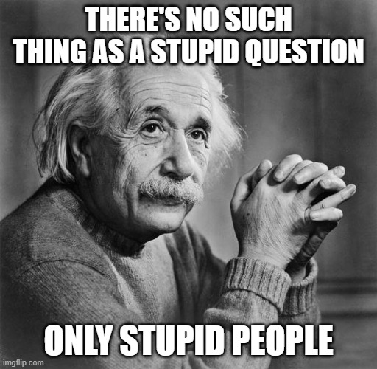
Rules

Slide 4
Agenda
Unit vs other tests
Why?
How?
Some do it better
Obstacles

Slide 5
Rules
„That all depends”
C# / .NET / Visual Studio == everything else
Key words for use in RFCs to Indicate Requirement Levels
https://tools.ietf.org/html/rfc2119
My „must” – in my team
In order to let it go, you need to possess it

Slide 6
Glossary
OUT/SUT – Object/Subject Under Test - class we are testing
Test Doubles
Mock – object with expectations
Stub - object behaving in given way
…
https://www.martinfowler.com/bliki/TestDouble.html
Lambda Expression e.g. (x,y) => x + y
Interface / contract
Dependency Injection

Slide 7
Reasons
Code works as expected ⭢ self-confidence
Usage documentation
Run code regardless large systems around
Mouse clicks reduction
Legacy systems – façade + facilitating injections
Code tested ⭢ (quite often) code well designed ⭢ SOLID
TDD ⭢ YAGNI

Slide 8
Frameworks – (unit) tests
(x)Unit frameworks, presented on XP2000 conference (.net 1.0 - 2002!)
nUnit
xUnit
jUnit
…
MS Tests
https://en.wikipedia.org/wiki/List_of_unit_testing_frameworks#.NET_programming_languages

Slide 9
NUnit
Attributes
manage lifecycle of test (setup, tests, tear down)
providing data to the test (e.g. values, range, generators, combinatorics)
helpers (e.g. SetCulture, Category)
Assertions
Classic
Assert.AreEqual( expected, actual )
Constraint-based
Assert.That(actual, Is.EqualTo(expected) )
Warning: what is expected, what is actual - change in order will lead to misleading error messages!!!
Test Context
Names of the test, properties. Rarely used

Slide 10
NUnit
Execution order
[TestFixture] - class
[OneTimeSetUp] / [SetUp]
[OneTimeTearDown] / [TearDown]
[Test] / [TestCase] / [TestCaseSource]

Slide 11
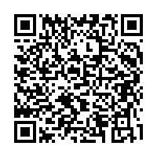
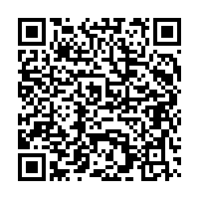
Demo
AttributesLifecycleExample
https://github.com/nemesissoft/Nemesis.TextParsers/blob/master/Nemesis.TextParsers.Tests/ExploratoryTests.cs
DataAttributesExample
https://github.com/nemesissoft/Nemesis.TextParsers/blob/master/Nemesis.TextParsers.Tests/Deconstructable/DeconstructableTests.cs

Slide 12
Demo
Bad naming
[Test] public void Hero8() { Assert.That(1+3==4);
Assert.That(3+1==4);
}
Good naming
[Test] public void AdditionShouldBeCommutative() { Assert.That(_calc.Add(1, 3), Is.EqualTo(4));
Assert.That(_calc.Add(3, 1), Is.EqualTo(4));
}

Slide 13
Demo
Bad naming
[Test] public void TestException() { try { //SomeAction() Assert.Fail(); } catch (Exception ex) { Assert.IsNotNull(ex); } }
Good naming
[Test] public void Parser_ShouldThrowUponMalformedInput() { var ex = Assert .Throws<ArgumentException>(() => transformer.Parse("Blah")); Assert.That(ex.Message, Does.Contain(expectedMessagePart));
}

Slide 14
Naming variants
AddShouldReturnProperResult
WhenAdd_ShouldReturnResultOfAddition
When_Add__Should_Return_Result_Of_Addition
Rewriting names ?

Slide 15
Naming - rewriting names
private static IEnumerable<TestCaseData> GenericInterfaceTests() { var data = new (Type type, Type generic, bool expectedResult)[] { (typeof(List<string>), typeof(IEnumerable<>), true), (typeof(int), typeof(IEquatable<int>), true), };
return (from d in data select new TestCaseData(d.type, d.generic).Returns(d.expectedResult) .SetName($"{d.type.GetFriendlyName()} {(d.expectedResult ? "->" : "!- ")} {d.generic.GetFriendlyName()})") ).ToList();
}
[TestCaseSource(nameof(GenericInterfaceTests))] public bool ImplementsGenericInterface(Type type, Type generic) => type.DerivesOrImplementsGeneric(generic);

Slide 16
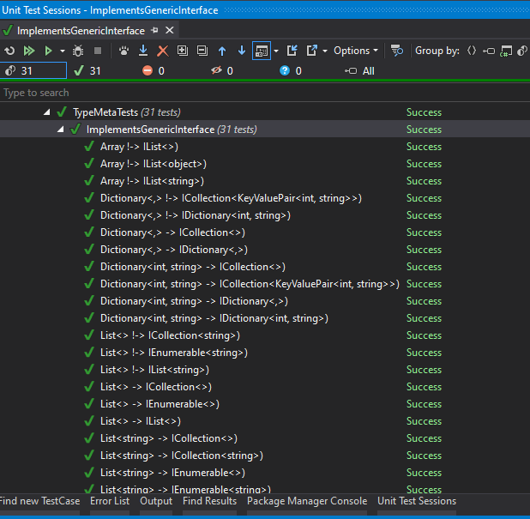
Naming - rewriting names

Slide 17
Running
Console and GUI runner
Visual Studio / RAD integration
Resharper – industry choice
Ctrl+U,Ctrl+R - runs current „context”
Ctrl+U,Ctrl+D – debug
Ctrl+U,Ctrl+U – repeat last run

Slide 18
Test doubles – managing dependencies
Create mock
_dep = new Mock<IMyDependency>()
_dep = new Mock<IMyDependency>( MockBehavior.Strict )
IMyDependency actualObject = _dep.Object;
Program mock so it will behave correctly. Fluently if possible.
_dep.Setup( x => x.MyMethod( "bar" ) ).Returns( 123 )
_dep.Setup( x => x.MyMethod( "foo" ) ).Throws( new Exception( "abc123" ) )
Or alternatively just check if mock was (not) called
_dep.Verify( x => x.MyMethod( "bar" ), Times.Exactly( 5 ) )
_dep.Verify( x => x.MyMethod( "blah-blah" ), Times.Never )

Slide 19
Demo - mocks
workshop placeholder/ad

Slide 20
Moq is not your only choice !!!
FakeItEasy
Nsubstitute
Telerik JustMock Lite
Typemock - isolator
RhinoMocks – old but mellow

Slide 21
FIRST
Fast
Isolated
Repeatable
Self-verifying
Timely

Slide 22
Fast
Don't call external systems (DB, web services, files) – double them
Reduce amount of data to process to a small, representative sample
Distinguish between integration/long running and fast unit tests - run the latter ones frequently
Unit tests execution should be „instant”

Slide 23
Isolated
One reason to fail ⭢ „one” assert per test
Potential problems in external systems are eliminated
Tests don't affect each other
Beware static classes/methods, singletons, databases!
Order of test execution must not matter!
Arrange-Act-Assert*

Slide 24
Repeatable
Static data, in-memory structures not cleaned up
External systems keeping state
Non-deterministic behaviour: threads/processes/order of test executions
Other classes which failed to initialize properly due to time
Dependable / deterministic
new Random(42)
Seeded (persisted) random values

Slide 25
Self-Verifying
No "partial success"
No field for interpretation
user cannot be forced to read console output
Possible exception: images, patterns, science
Green (pass) == GOOD, Red (fail) == BAD
Test without assertions will often pass in most cases ;-)

Slide 26
Timely
Don't wait ages to write the test
Test-Driven Development
Test-After Development

Slide 27
AAA
Arrange
Creates "context" for the test
Use testing doubles as much as possible here
Act
One single operation we want to run using "context" prepared in Arrange part
Capture various results/side effects of operation
Assert
Test all results, with appropriate granularity
Check all side effects (expected, not allowed)

Slide 28
AAA
[Test]
public void WhenAdd_ShouldReturnResultOfAddition()
{
//arrange
var x = 10;
var y = 0.5;
var calculator = new Calculator();
//act
var result = calculator.Add( x, y );
//assert
Assert.That( result, Is.EqualTo( 10.5 ) );
}

Slide 29
AAA
[TestFixture]
public class Calculator_WhenAdd_ShouldBeCommutative { double _result1; double _result2;
[TestFixtureSetUp] public void ArrangeAndAct() { //arrange var x = 10; var y = 20.0; var objectUnderTest = new Calculator();
//act _result1 = objectUnderTest.Add(x, y); _result2 = objectUnderTest.Add((int)y, x); }
[Test] public void ShouldProduceCorrectResults() { Assert.That(_result1, Is.EqualTo(30.0)); Assert.That(_result2, Is.EqualTo(30.0)); }
[Test]
public void ShouldBothResultsBeEqual() =>
Assert.That( _result1, Is.EqualTo( _result2 ) );
}

Slide 30
Legacy systems
Static Methods
Facade
Seam
„Static” IoC
Composition/substitution

Slide 31
Best practices
MySystem.Tests – pattern recognized by CI/CD
[InternalsVisibleTo("*.Tests")]
[InternalsVisibleTo("DynamicProxyGenAssembly2")]
Subfolders in main solution
...and for name of test use pattern ClassName_WhenSomeMethodCalled

Slide 32
Obstacles
Hard to start writing tests - ask people who already do it!
Find the right balance (e.g. do you need to test auto-properties or every single implementation detail?)
False sense of security
Management
Code coverage - reduces the tests to a single number. Is it going to affect your bonus?
Bloody time wasters - these unit test writing developers
Maintenance costs
No team review => tests are understood by creators only

Slide 33
„Secret tests”
Public vs private members
System is entitled to it’s „secrets” / implementation details !?
using Moq.Protected; var mock = new Mock<MyClass>(); mock.Protected() .Setup<int>("MyProtectedGetIntMethod") .Returns(1);

Slide 34
Summary
BEFRIEND AND „LOVE” YOUR TESTING FRAMEWORK
what you want your code to do and how your team want to use it
Composition over inheritance - IoC
code & test reviews
Prepare your own team tools & standards
FIRST, AAA
CI / CD / CD
„Live” unit tests
Symmetry tests

Slide 35
TODO
TDD Katas

Slide 36
Q&A
Thank you for attention

